Slide 1
Kafka

Slide 2
Apache Kafka is an open-source distributed event streaming platform.
Open-source: It means it will be available free of cost
Distributed: It means it works on the distributed environment.
Event Streaming: It means way of producing and consuming data.
Kafka helps by:
Decoupling services
Scalability
Replayability: It means even missed event can be processed later.
Efficiency: There will be one connection to per service, not many to many.

Slide 3
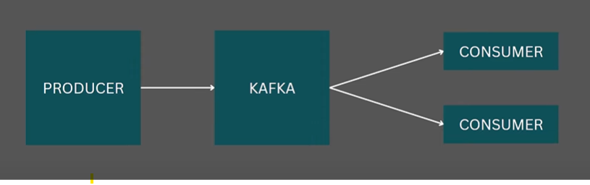
Event Streaming means continuously capturing events (data) in real-time, storing them in a log (like a timeline), and allowing systems to react to them –either immediately or later.
Producer: Producer will create an event.
Kafka: Events are stored in the Kafka.(Generally Events are stored in the kafka topic).
Consumer: It means Listening these events and they are processing it.
Here there will be more then 100s of Producer and more then 100s of Consumer.
Example: Notification, SMS Service, Invoice Service, etc…

Slide 4
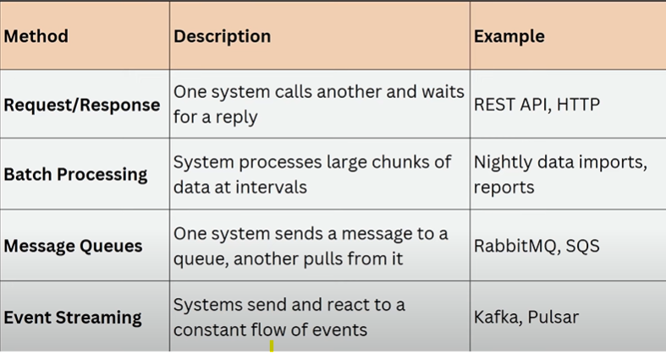
Here apart from the event stream there are many ways of pass the data. Shown In the below table.

Slide 5
Example to understand Kafka, How it works: WhatsApp group
There are people who sending a messages (Producers).
Group chart that we have is nothing but Kafka topic, Normally messages and events that are going to kafka go in topic.(you might have 10 or 20 or 30 group in whatsapp, here every group is a topic).
There are people who are reading the messages (Consumers).
The coolest part is a group member is offline, then once he online then he will receive the messages, Like wise in Kafka if 10 consumers listening to a topic and 3 of there were offline (Some network issue) means messages were not losses. When those services are up then start consuming the messages from where they have left. It means there is a concept of offset from where we can read the unread messages. And messages are always stored in the orders.
And Multiple people can read the same messages.(Concept Calles Multiple consumer).

Slide 6
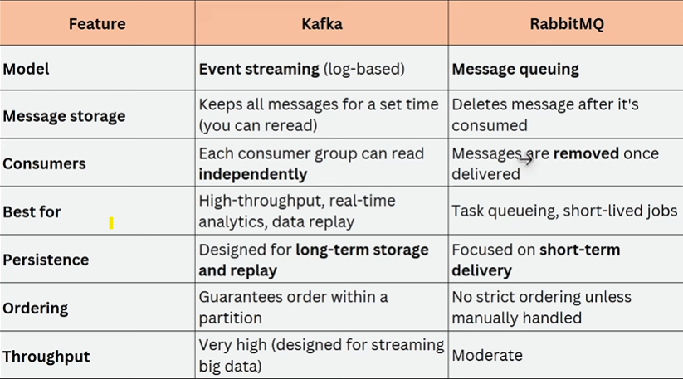
Difference Between the Kafka And RabbitMQ

Slide 7
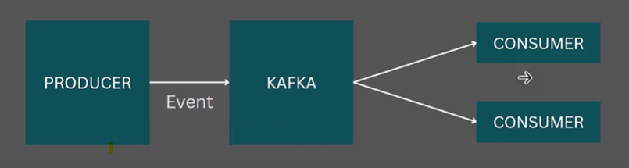
Kafka Architecture And Components:
Event
Producer
Consumer
Topics
Partitions
Consumer Groups
Offset
Consumer Rebalancing
Event means Any meaning full message or action sent to the kafka.
Producer is someone who produces the message or produces the event.(In Kafka Producer is any app or data that sends data to the Kafka). In real n –number of producers.
Consumer nothing but Listeners or receivers, (means consuming that particular event.)
Topics: It is nothing but a channel of receiving messages, It is a way of segregating messages within the Kafka. And within topic there is tons of messages. And within topic also have the concept called partitions.
Partition:
Consumer Groups:
Offset:
Consumer Rebalancing: It is a process of redistributing the topic partition among the consumer within the consumer group.

Slide 8
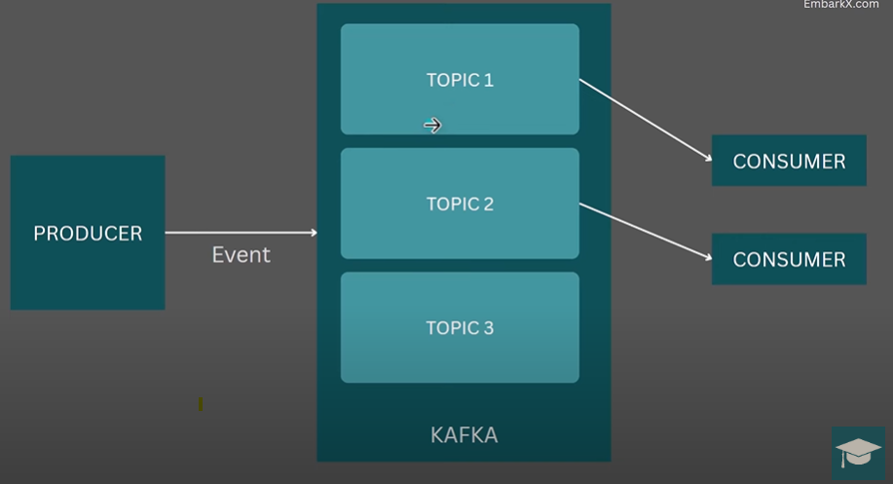
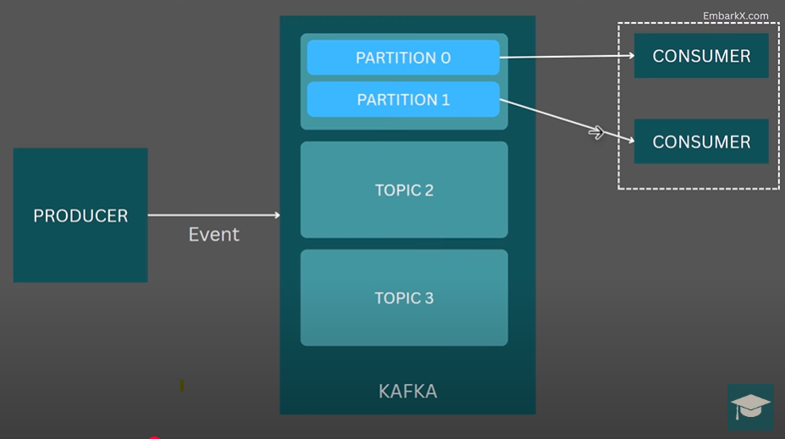
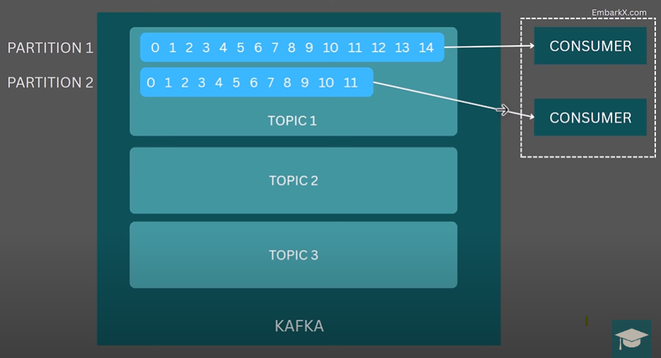
Image for the Producer, Event ,Topic and Consumer
Image for the Topic, Partition, Consumer Group
Image for the Partition and Offset
09. Offset Is like a book mark like of your last read message.
Within partition will be having the offset.

Slide 9
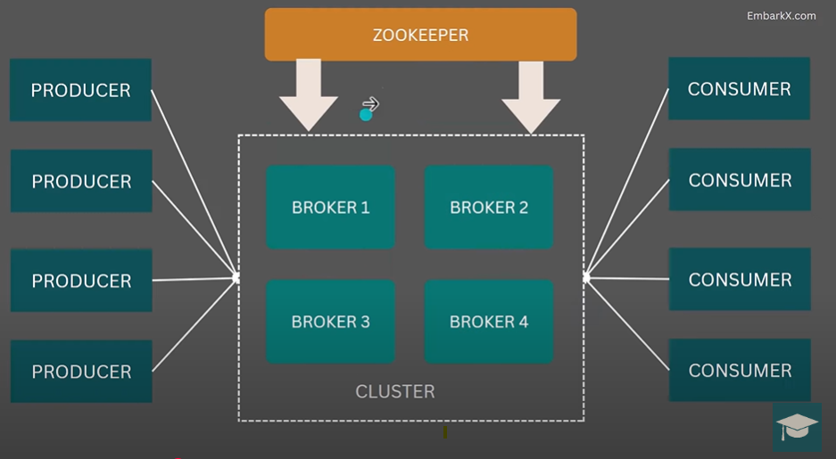
In Kafka we can have multiple instance of kafka running. Here we can see in the image that there all 4 kafka running in the Cluster. Because better managing the load.
Broker means one instance of the kafka.
Zookeeper: Help manage and coordinate different kafka broker and track which broker has which data.
zookeeper manages the Cluster.
In the newer version kafka is running away from the Zookeeper because whenever we install the kafka we need to install the zookeeper also and also first we need to start the zookeeper and then start the kafka.
In new version Kafka introduced kRaft mode, Where kRaft mode Zookeeper is not needed.

Slide 10
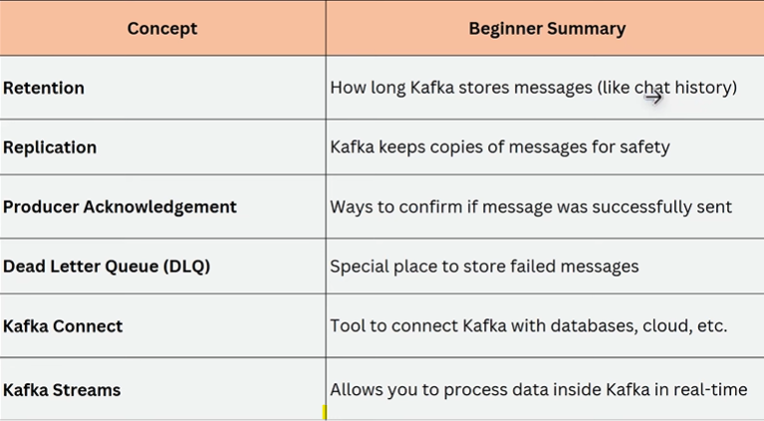
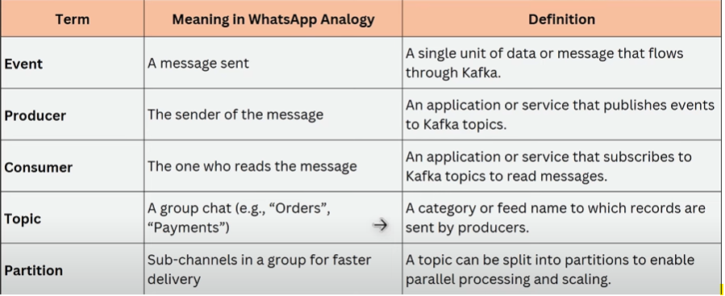
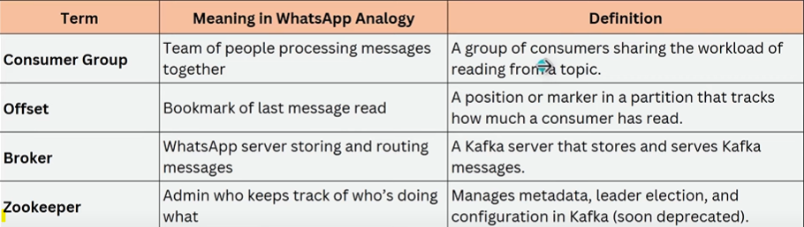
Here Terms along with its definition or meaning

Slide 11
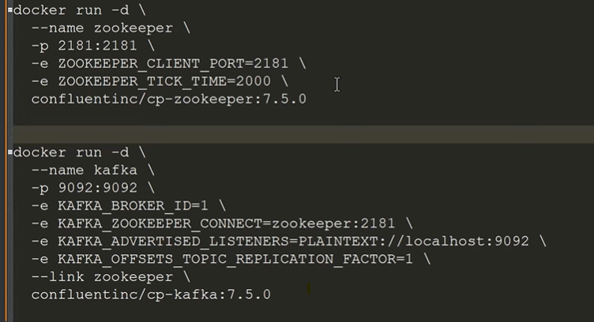
NOTE: Make sure the zookeeper container is already running before you start Kafka
Here these are the commands to run the kafka
Here first container is for the zookeeper and second container is for the kafka.
* Run this below command to create a zookeeper container in the docker.
docker run -d --name zookeeper -p 2181:2181 -e ZOOKEEPER_CLIENT_PORT=2181 -e ZOOKEEPER_TICK_TIME=2000 confluentinc/cp-zookeeper:7.5.0
* To create Kafka container in the docker run the below command: docker run -d --name kafka -p 9092:9092 -e KAFKA_BROKER_ID=1 -e KAFKA_ZOOKEEPER_CONNECT=zookeeper:2181 -e KAFKA_ADVERTISED_LISTENERS=PLAINTEXT://localhost:9092 -e KAFKA_OFFSETS_TOPIC_REPLICATION_FACTOR=1 --link zookeeper confluentinc/cp-kafka:7.5.0

Slide 12
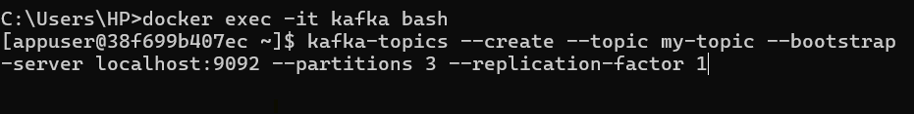
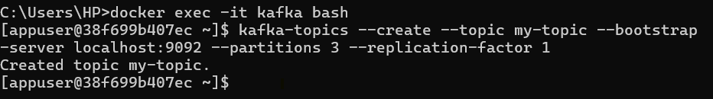
docker ps: It will give the list of container present in the docker.
docker exec -it kafka bash: This command is telling the docker, that hey take me inside the container named kafka so that I can run commands inside that environment.
exec means execute a command inside a running container.
-it : i means keep the input open. And t means allocate a terminal.
Here once the command executes (docker exec -it kafka bash): immediately it will create the environment like below
[appuser@38f699b407ec ~]$ And then what ever the command we run all command will run inside the kafka environment. As we can see the command in the below image.
Here in the image we can see that first we are creating the topics inside the kafka.
Here my-topic is the name of the topic which is created inside the kafka.
--bootstrap-server localhost:9092 is telling the kafka is running in this localhost server 9092.
--partitions 3 means we are creating 3 partition inside the topic (Means we are creating the topic with the 3 partition).
--replication-factor 1: This tells the kafka how many copies of each partition to maintained.
Here topic is created with the name is my-topic

Slide 13
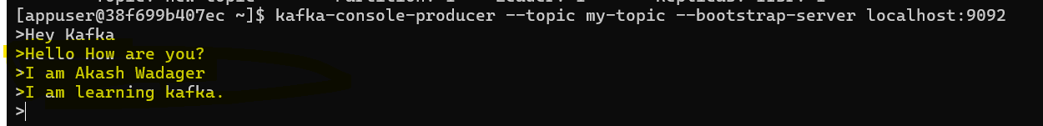
kafka-topics --list --bootstrap-server localhost:9092 Here this command will give the list of topics in the kafka.
We can see the details about the respective topic, as shown in the below image:
Producer Client Tool: Which is given by the Kafka, which we can use to produce the message. we can see that command in the image.
Here yellow marked are the messages (Live producer input mode) and this will be stored inside the topic.

Slide 14
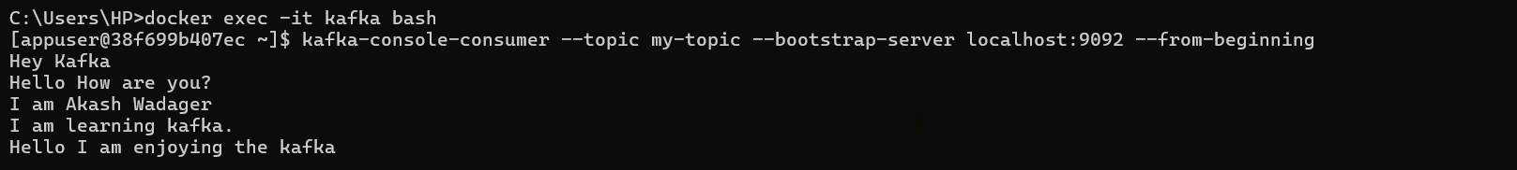
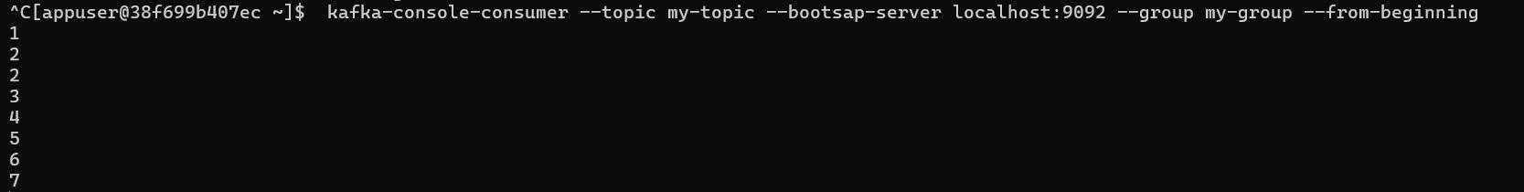
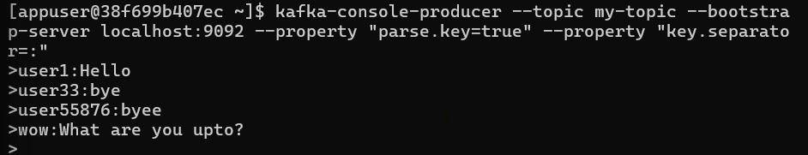
Here we are creating the consumer in the different command prompt using the consumer tool, This allow us to listen the message from the particular topic.
In a consumer group only one consumer will read the one message, not by all. Here my-group is the consumer group name.

Slide 15
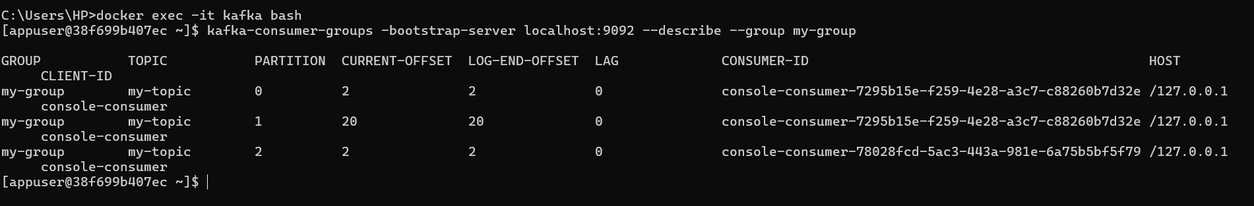
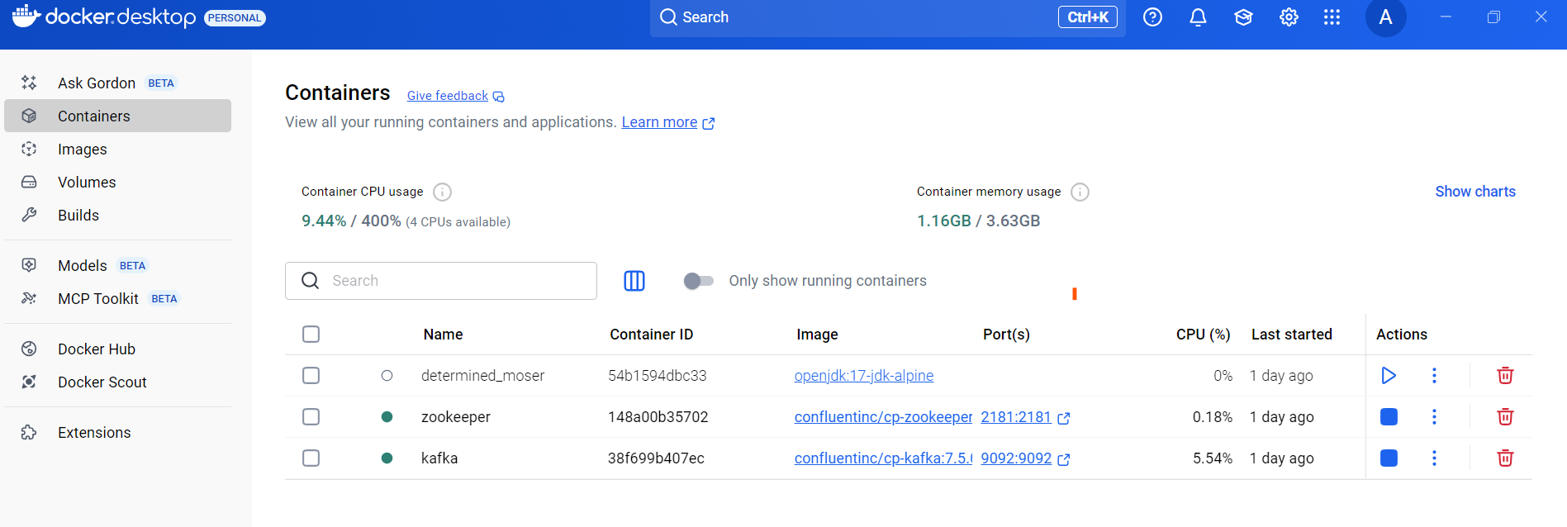
Here in the docker we can see the zookeeper and kafka containers

Slide 16
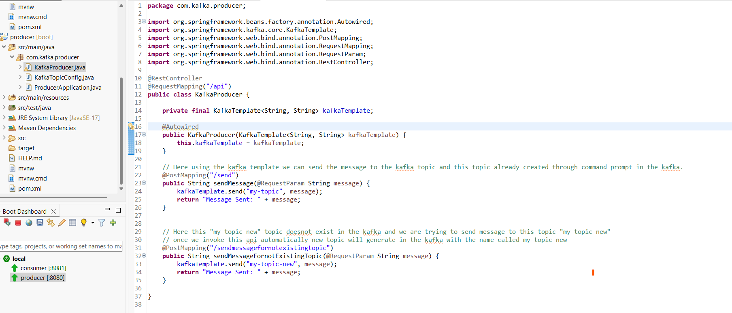
Kafka Producer Setup:

Slide 17
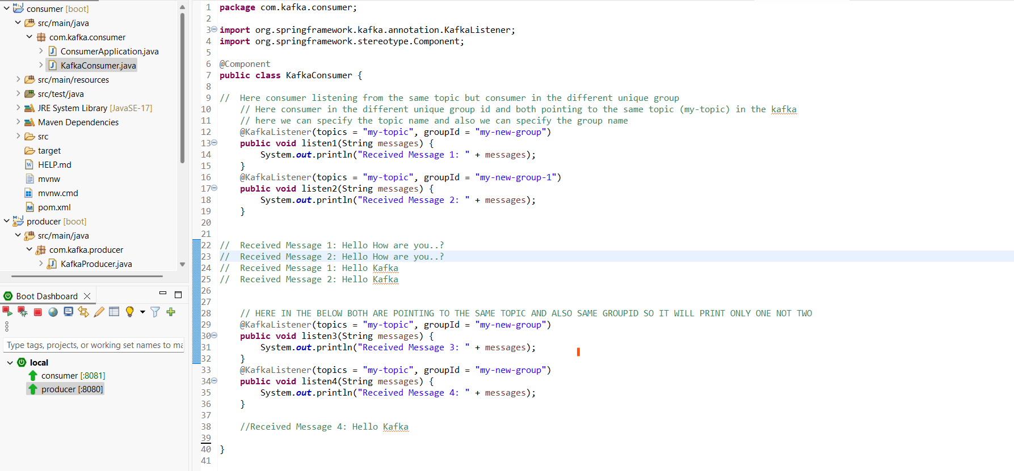
Kafka Consumer setup:

Slide 18
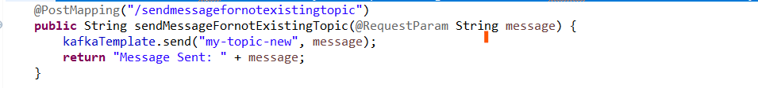
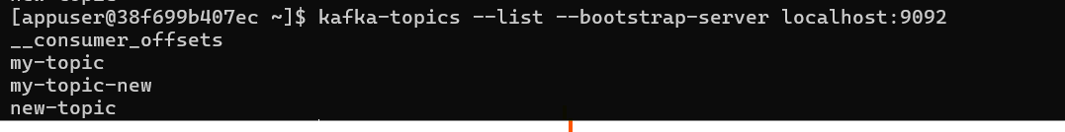
Here we can get the list of topic exist in the kafka:
Here we can see the __consumer_offsets that is the internal topic created by kafka itself to manager consumer partition offsets.
Creating the topic Programatically:
Here this "my-topic-new" topic doesn't exist in the kafka and we are trying to send message to this topic "my-topic-new“ And once we invoke this api automatically new topic will generate in the kafka with the name called my-topic-new
Here we can see that new created topic through code . And below images shows the list of topic, Including the new topic.

Slide 19
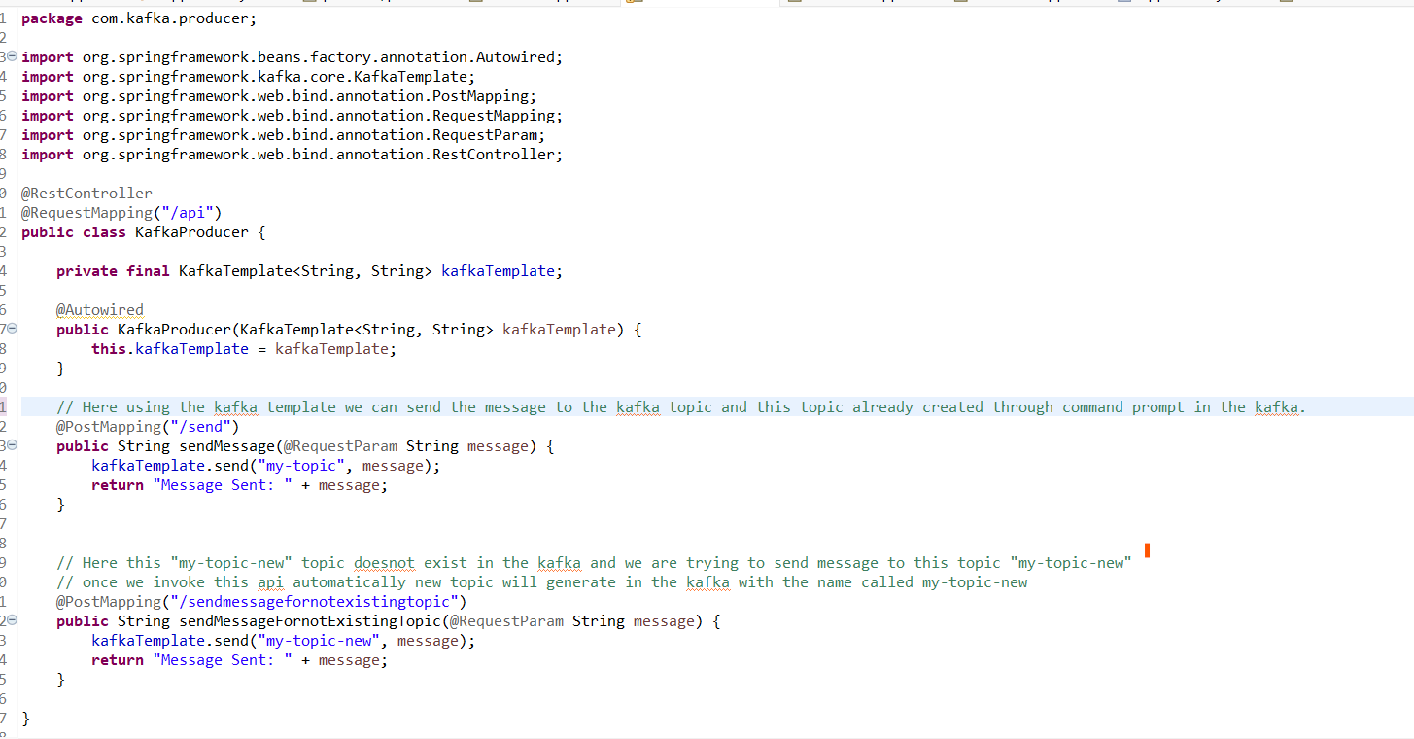

Slide 20
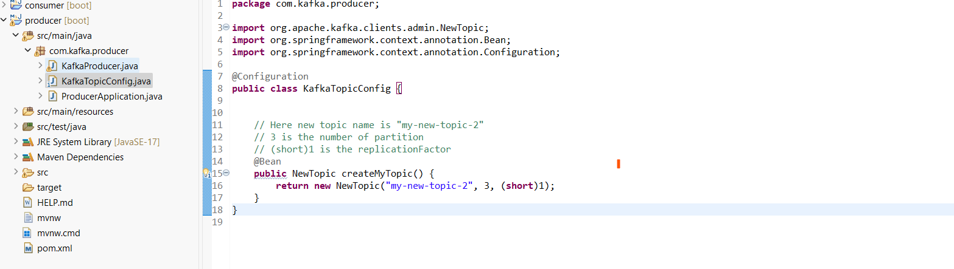
Another way to create new topic with the partition through the java code:

